Slide 1
JCrete4Kids 2018
Lego Mindstorms workshop
Nikhil Nanivadekar
@nikhilnanivade
Summer 2018

Slide 2
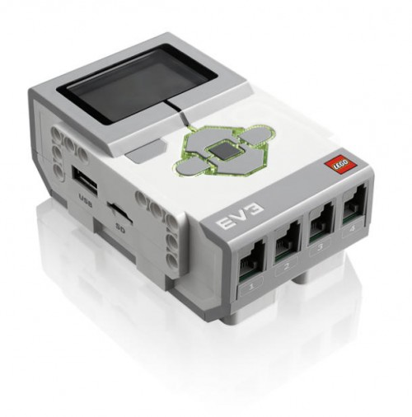
The Heart of the EV3
TI Sitara AM1808
ARM9, 300Mhz
64MB RAM / 16MB Flash
Analog to Digital Converter
4 Motor Ports
4 Sensor Ports
Bluetooth / USB
MicroSD
Slide copied from: http://www.slideshare.net/steveonjava/devoxx4kids-lego-workshop?ref=http://steveonjava.com/java-lego-workshop-4-kids/

Slide 3
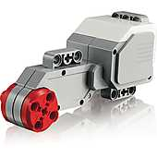
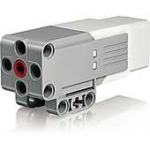
EV3 Motors
Slide copied from: http://www.slideshare.net/steveonjava/devoxx4kids-lego-workshop?ref=http://steveonjava.com/java-lego-workshop-4-kids/

Slide 4
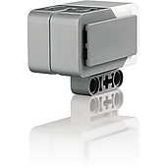
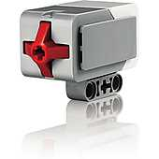
EV3 Sensors
Slide copied from: http://www.slideshare.net/steveonjava/devoxx4kids-lego-workshop?ref=http://steveonjava.com/java-lego-workshop-4-kids/

Slide 5
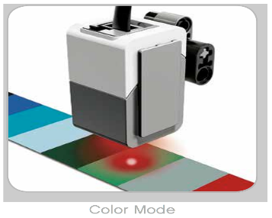
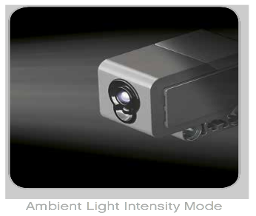
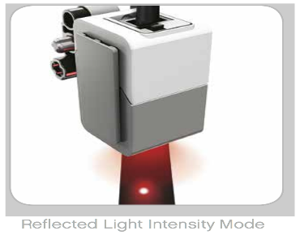
Color and Light Sensor
Slide copied from: http://www.slideshare.net/steveonjava/devoxx4kids-lego-workshop?ref=http://steveonjava.com/java-lego-workshop-4-kids/

Slide 6
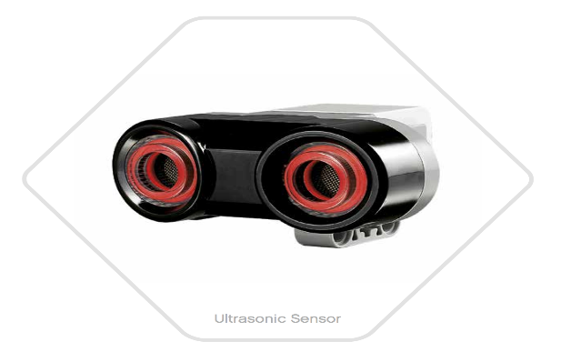
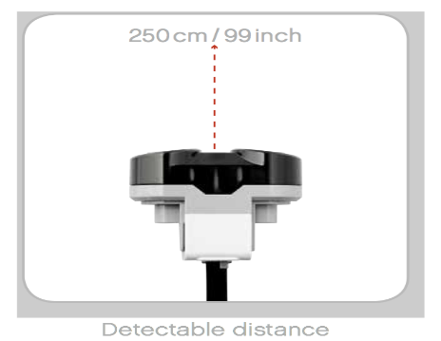
Ultrasonic Sensor
High frequency
sound waves
Measuring mode Vs Presence Mode
Slide copied from: http://www.slideshare.net/steveonjava/devoxx4kids-lego-workshop?ref=http://steveonjava.com/java-lego-workshop-4-kids/

Slide 7
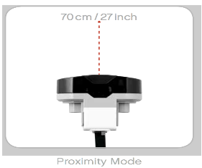
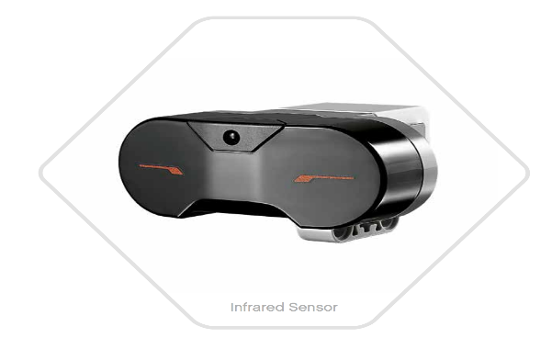
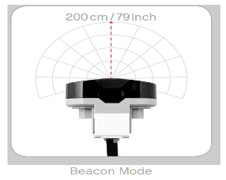
Infrared Sensor
Slide copied from: http://www.slideshare.net/steveonjava/devoxx4kids-lego-workshop?ref=http://steveonjava.com/java-lego-workshop-4-kids/

Slide 8
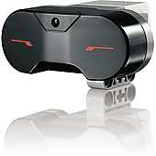
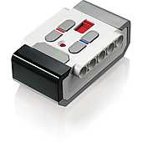
Remote Control
Slide copied from: http://www.slideshare.net/steveonjava/devoxx4kids-lego-workshop?ref=http://steveonjava.com/java-lego-workshop-4-kids/

Slide 9
Build Football Playing Robot

Slide 10
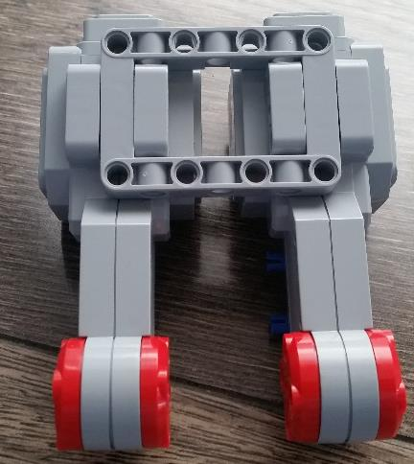
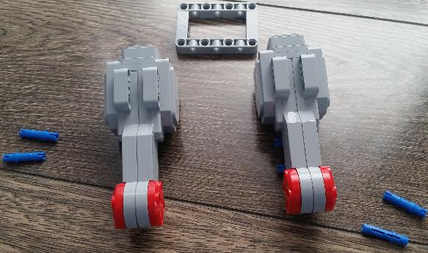
Assemble base

Slide 11

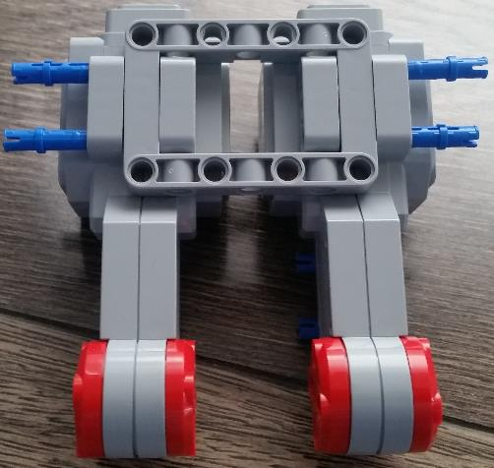
Assemble base

Slide 12
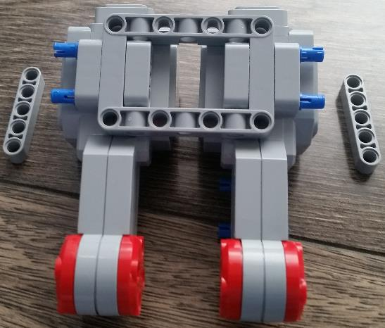
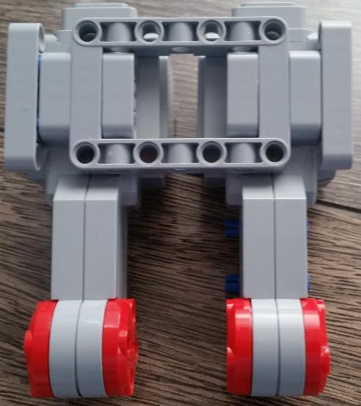
Assemble base

Slide 13
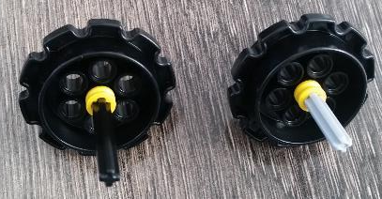
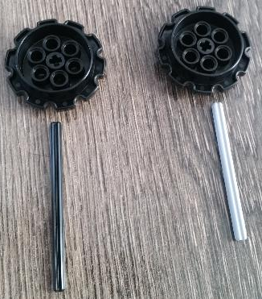
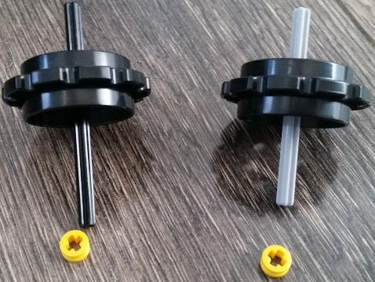
Assemble base
Yellow lock nuts on both sides

Slide 14
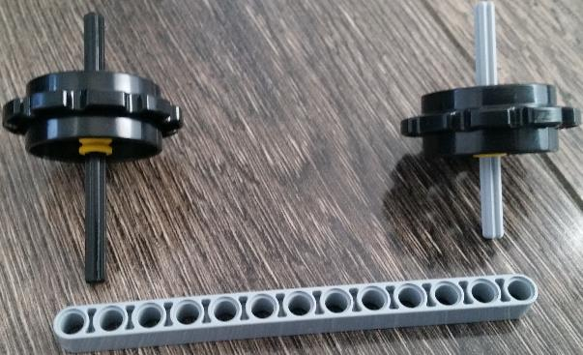
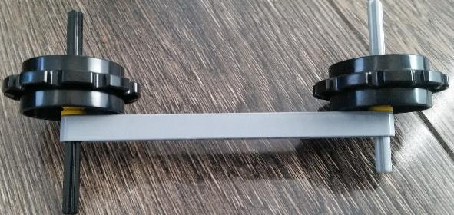
Assemble base

Slide 15
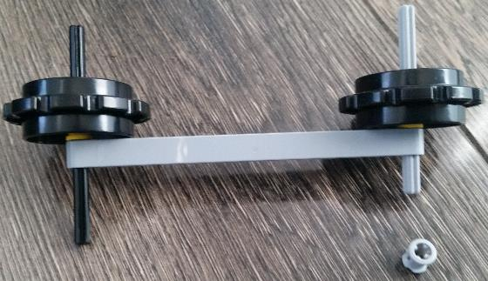
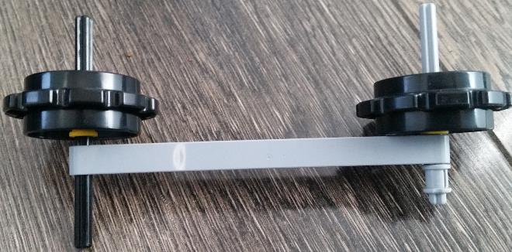
Assemble base

Slide 16
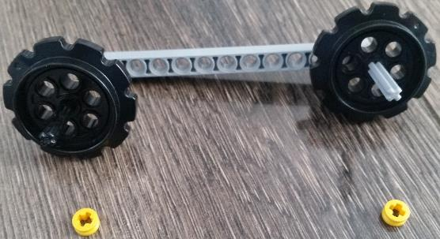
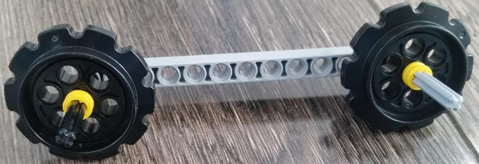
Assemble base

Slide 17
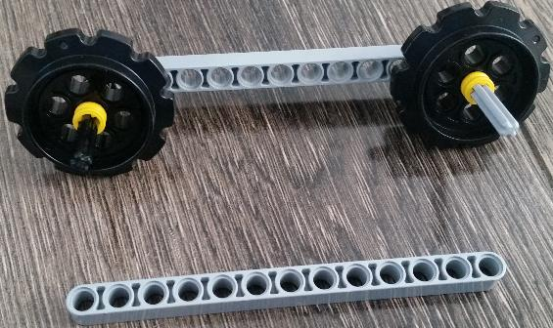
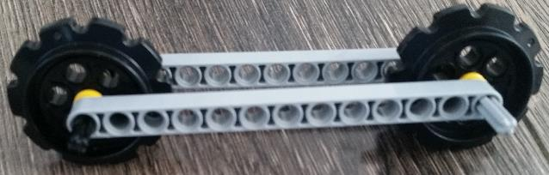
Assemble base

Slide 18
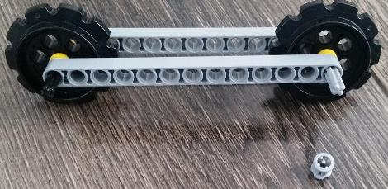
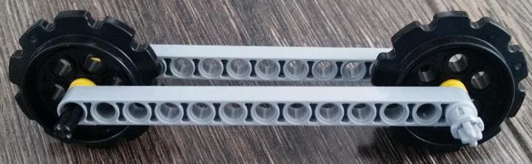
Assemble base

Slide 19
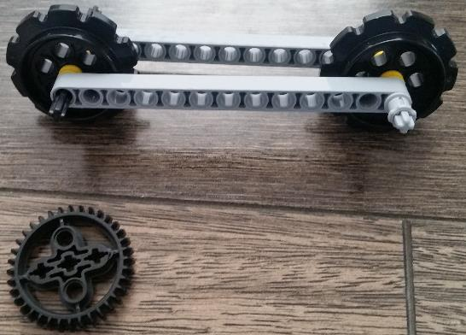
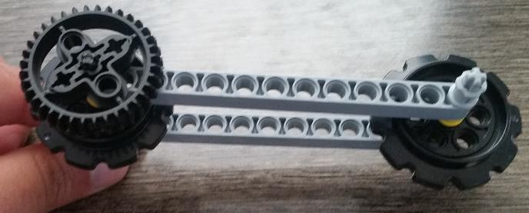
Assemble base

Slide 20
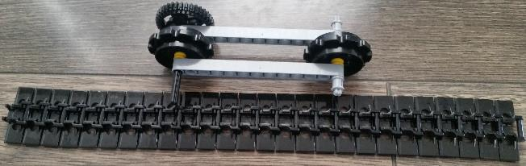
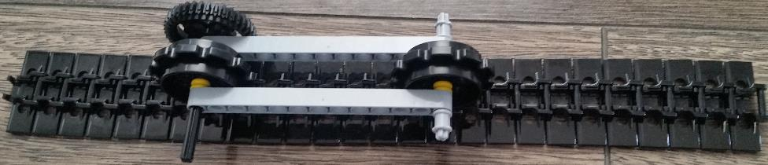
Assemble base

Slide 21
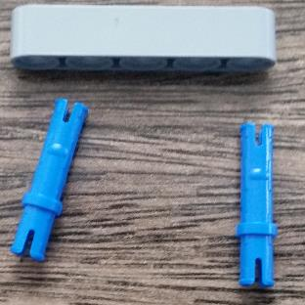
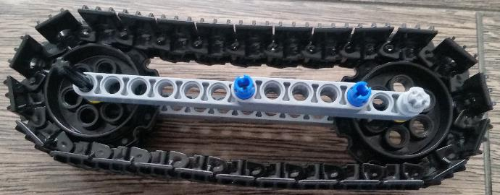
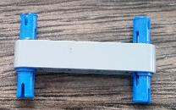
Assemble base

Slide 22
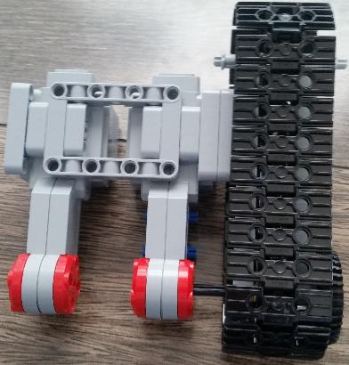
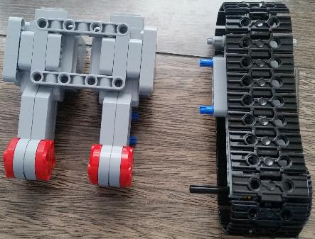
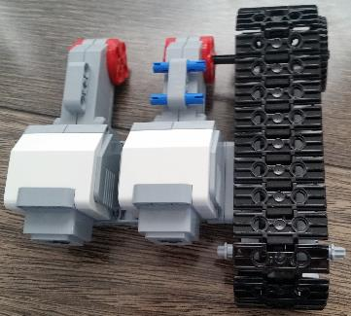
Assemble base

Slide 23
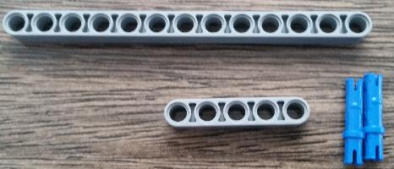
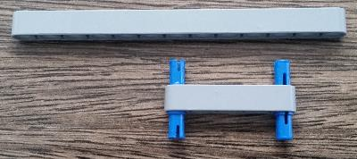
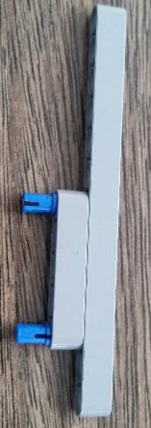
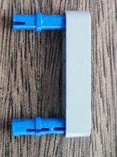
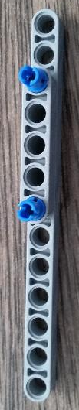
Assemble base

Slide 24
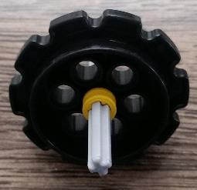
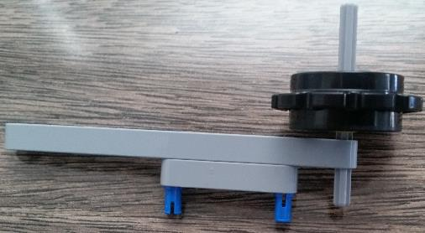

Assemble base

Slide 25


Assemble base

Slide 26



Assemble base

Slide 27


Assemble base

Slide 28


Assemble base

Slide 29


Assemble base

Slide 30


Assemble base

Slide 31


Assemble base

Slide 32

Assemble base

Slide 33

Assemble base

Slide 34



Assemble base

Slide 35



Assemble base

Slide 36



Assemble base

Slide 37



Assemble base

Slide 38




Assemble base

Slide 39





Assemble base

Slide 40




Assemble the Leg

Slide 41


Assemble the Leg

Slide 42




Assemble the Leg

Slide 43



Assemble the Leg

Slide 44




Assemble the Leg

Slide 45



Assemble the Leg

Slide 46





Assemble the Leg
2 pieces:
one for left
one for right

Slide 47




Assemble the Leg

Slide 48




Assemble the Leg

Slide 49



Assemble the Brick

Slide 50



Assemble the Brick

Slide 51



Assemble the Brick

Slide 52



Connect IR Sensor

Slide 53
Connections to the Brick
Motor/Sensor | Port
Left | B
Right | C
Leg | A
IR Sensor | 1

Slide 54


Assembled Player

Slide 55
Program Football Playing Robot

Slide 56
Install the EV3 Software
Ask an instructor for help
You can download it from: https://www.lego.com/en-us/mindstorms/downloads/download-software
Click on Plus (+) sign at the top to start a blank project
You can also follow the instructions to see how to program from: https://www.lego.com/en-us/mindstorms/learn-to-program
Program is given on the next page which you need to implement

Slide 57

Program
Click on File > New Project

Slide 58

Program
Once the new project opens you are ready to code
At the bottom of the screen, choose Flow Control -> Loop

Slide 59

Program
Add the Switch Cases: At the bottom choose Flow Control -> Switch
Change the sensor to Infrared Sensor, mode to be remote
Change the port to 1

Slide 60

Program
Now start adding the cases

Slide 61

Program
Case 1
Top left button of remote
Change steering to time mode
You can adjust the power. Do not give a lot of power otherwise your robot will fall. Less power will make it go slow. Choose wisely

Slide 62

Program
Case 2
Bottom left button of remote
Change steering to time mode
You can adjust the power. Make sure power is of opposite sign that of case 1. Do not give a lot of power otherwise your robot will fall. Less power will make it go slow. Choose wisely

Slide 63

Program
Case 3
Top Right button of remote
Add steering pilot
Change to degree mode. You can change power and angle of rotation. Choose wisely.

Slide 64

Program
Case 4
Bottom right button of remote
Add steering pilot
Change to degree mode. You can change power and angle of rotation. Change the angle of rotation to opposite of Case3. Choose wisely.

Slide 65

Program
Case 5
Top Left and Top right button of remote at the same time
Add small motor for leg
Make sure that the motor is powerful enough to kick and also add a return to the leg to come back once kicked

Slide 66
Football Rules

Slide 67
Rules
Each match will last 5 minutes
Team with the highest goals win
One participant from each team can control the remote
In case of a tie, additional 2 minutes will be given
If there is still a tie, then there will be a penalty shootout
If there is still a tie, then a coin toss will decide

